Slide 1
Machine Learning:
Neural Networks and Assessment
Link to this document
Applied Python

Slide 2
What are we doing?
Learning Objectives
By the end of this week, you should:
understand the basics of artificial neural networks
identify the key components of ANNs
know how to use a multilayer perceptron algorithm
Measurable Outcomes
By the end of this week, you should be able to:
implement an MLP in code
scale data to feed into an algorithm
more effectively assess the predictive capabilities of a given model

Slide 3
ARTIFICIAL NEURAL NETWORKS

Slide 4
Artificial Neural Networks: ANN
You've already looked at the KNN algorithm for machine learning. There are many more to choose from. One of the most popular kinds at the moment is the artificial neural network. An artificial neural network (ANN) is a machine-learning system inspired primarily by animal neurons.
Layers of neurons - called nodes - are connected to each other via edges and transmit a signal which is weighted.
Each node represents some property of the data. What property? Only the input and output nodes have definite attributes associated with them. The rest are some combination of inputs.
Each signal is a number, and the output of each node is determined by an activation function based on its input signals.
Usually, the input and output layer nodes are known, but any inner layers are hidden: that is, their purpose and function is not known to the programmer.

Slide 5
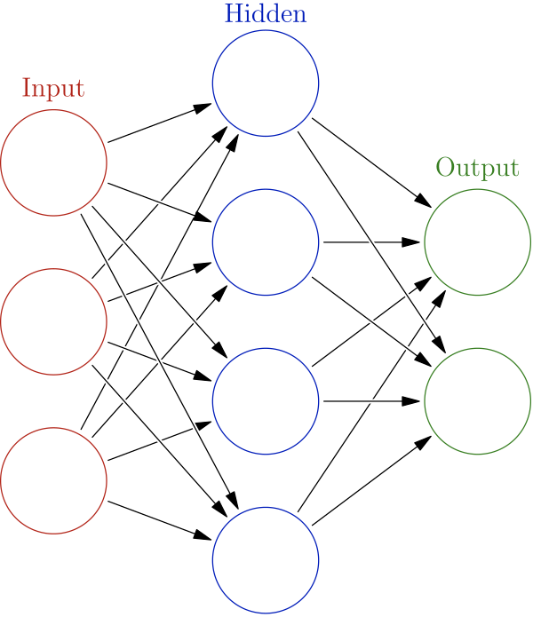
ANN: a model
In the image on the right:
Each circle is a node
Each arrow is a connection (also known as edge) from one layer to another
There are three layers: one input, one output, and one inner hidden layer.
Note: this is not what every ANN looks like; it is just a simple model.
https://en.wikipedia.org/wiki/Machine_learning

Slide 6
Perceptrons and MLPs
There are several ML algorithms which make use of ANNs. A perceptron is one of them. A perceptron is the ANN equivalent of a singular neuron: it's got inputs, an output, and an activation function.
A multilayer perceptron (MLP) is a type of ANN algorithm in which:
there are at least two perceptrons (nodes), and
the connections (edges) only connect toward the output. This type of ANN is called a feedforward ANN.

Slide 7
Loss function and backpropagation
During training of many ML algorithms, it is common for the algorithm to calculate the performance. This is done using one of any number of types of loss functions. This function results in some numeric measure which represents the sum of the errors made during training. The goal is to minimize the result of the loss function.
Many ML algorithms - in particular, ANNs - feed some amount of information back into the model to do things like re-adjust the weights of edges. This is called backpropagation. Backpropagation actually calculates the gradient of the loss function.

Slide 8
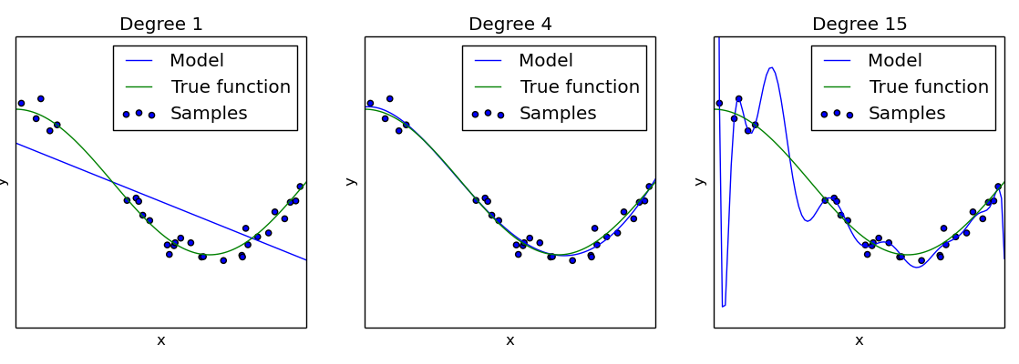
Side note: Optimization
When creating a model, the goal is to fit the data as effectively as possible - in other words, to create as effective a hypothesis as possible.
If the model generalizes too much, it will likely be underfit. If the model becomes very specific, then it will likely be overfit.
https://scikit-learn.org/0.15/auto_examples/plot_underfitting_overfitting.html

Slide 9
CONTEXTUALIZATION

Slide 10
ML: the process
As a reminder: the process of supervised ML is pretty simple. There are only a few steps:
Wrangle (including a couple you haven't seen yet):
formatting, NaN, nulls, etc.
Separate into feature vector and target
Split into training and testing
(If necessary) transform the feature vector
Train
Use - i.e. predict and validate

Slide 11
ML: import
Let's contextualize ANNs by implementing an MLP to make predictions on the same dataset as before: iris.
Just as you've done in the past, import the appropriate packages/modules. In this case, you'll want the StandardScaler and train_test_split modules again, and swap the KNN modules the MLPClassifier module.
import pandas as pd
import matplotlib.pyplot as plt
from sklearn.model_selection import train_test_split
from sklearn.preprocessing import StandardScaler
from sklearn.neural_network import MLPClassifier

Slide 12
ML Step 1a: Wrangle
As before, you'll want to load the dataset you want to work with (in this case, iris) into a DataFrame.
As a reminder: you will always want to go through the full wrangling process here (i.e. deal with dupes, missing values, malformed, et al.). It's just skipped in the slides for brevity.
import pandas as pd
import matplotlib.pyplot as plt
from sklearn.model_selection import train_test_split
from sklearn.preprocessing import StandardScaler
from sklearn.neural_network import MLPClassifier
def main():
file_path = 'iris.csv'
df_iris = pd.read_csv(file_path)
if __name__ == '__main__':
main()

Slide 13
ML Step 1b: split and split
As before, the next thing you'll need to do is:
separate the dataset into a feature vector X and a target y.
separate the feature vector and target into training and testing sets.
# ... previous code goes here
def main():
# ... previous code goes here
X = df_iris.drop(columns='Species')
y = df_iris['Species']
X_train, X_test, y_train, y_test = train_test_split(X, y, random_state=1, stratify=y)
if __name__ == '__main__':
main()

Slide 14
ML Step 1c: Transform
As before: because MLP uses more than one feature at once in its maths, you'll need to transform the feature vector so that no individual feature is weighted more strongly than the rest.
# ... previous code goes here
def main():
# ... previous code goes here
tfr_std = StandardScaler()
tfr_std.fit(X_train)
# transform and wrap back into DataFrame
X_train = pd.DataFrame(tfr_std.transform(X_train), columns=X_train.columns, index=X_train.index)
X_test = pd.DataFrame(tfr_std.transform(X_test), columns=X_test.columns, index=X_test.index)
if __name__ == '__main__':
main()

Slide 15
ML Step 2: Train
Now that you've got scaled training and testing sets, it's finally time to train the model!
There are a couple keyword arguments here:
hidden_layer_sizes is a tuple and represents how many hidden layers you would like. (10, 10, 10) is three hidden layers, each of which have 10 nodes.
max_iter tells the algorithm how many times to cycle through the model (and readjust values along the way). This is part of the backpropagation step.
# ... previous code goes here
def main():
# ... previous code goes here
model_mlp = MLPClassifier(hidden_layer_sizes=(10, 10, 10), max_iter=1000)
model_mlp.fit(X_train, y_train)
if __name__ == '__main__':
main()

Slide 16
ML Step 3: predict
Now that the model has been trained, it's time to make some predictions. Two reminders:
You reserved a whole dataset for this purpose: X_test and y_test.
The naming convention for this set of predictions is y_pred.
(You haven't actually used y_pred at all - not even last week - but its use will become apparent shortly.)
# ... previous code goes here
def main():
# ... previous code goes here
# make all the predictions
y_pred = model_mlp.predict(X_test)
if __name__ == '__main__':
main()

Slide 17
ML Step 3: validate
As before: to see how well the model has done, simply use the .score() method, and give it the test data.
(Note: .score() is basically calculating y_pred (from the previous slide) behind the scenes, using X_test; then comparing to y_test known true labels.)
# ... previous code goes here
def main():
# ... previous code goes here
print('accuracy:', model_mlp.score(X_test, y_test))
if __name__ == '__main__':
main()

Slide 18
ASSESSING PERFORMANCE

Slide 19
Is this any good?
Testing your model is as simple as feeding it the testing dataset. And you've already seen one metric for assessing performance of the model: the mean accuracy value, via the score() method of whatever model you're using. But what if you want more information on how the model performs? For instance: how good is it at identifying whether an item is a particular label? How good is it at identifying whether an item is not a particular label? How does the model perform compared to random?

Slide 20
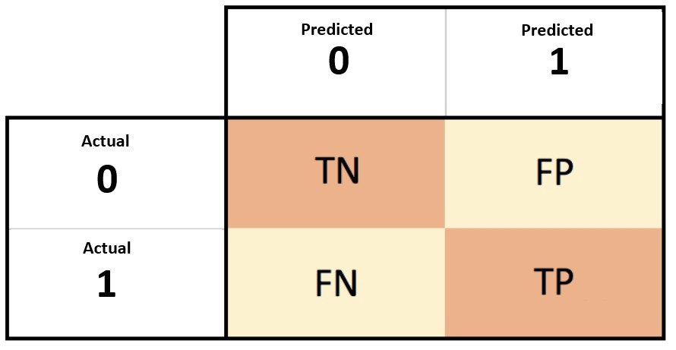
The Confusion Matrix
The confusion matrix is a very useful way to visually, as well as mathematically, assess the performance of a particular classification model.
Actual and predicted labels are mapped to a 2D matrix. From this, several useful quantities can be calculated, includes sensitivity (true positive rate) and specificity (true negative rate).
Confusion matrices can be used for any size classification model - not just binary.
source: https://miro.medium.com/max/1780/1*LQ1YMKBlbDhH9K6Ujz8QTw.jpeg

Slide 21
The Confusion Matrix: context
sklearn comes with a host of assessment tools in in the metrics package. The confusion_matrix package, unsurprisingly, allows you to construct a confusion matrix.
# ... previous code goes here
from sklearn.metrics import confusion_matrix
def main():
# ... previous code goes here
# create a confusion matrix
conf_matrix = confusion_matrix(y_test, y_pred)
print('confusion matrix:', conf_matrix)
if __name__ == '__main__':
main()

Slide 22
The Confusion Matrix: context
It might be useful to actually visualize the confusion matrix; it'll give a bit more context to the numbers you're currently seeing in the console.
Note that this is a slightly different way of plotting than you might be used to.
# ... previous code goes here
from sklearn.metrics import confusion_matrix, ConfusionMatrixDisplay
def main():
# ... previous code goes here
# create a confusion matrix display object
cm_disp = ConfusionMatrixDisplay(confusion_matrix=conf_matrix, display_labels=model_mlp.classes_)
# plot the confusion matrix display object
fig, axes = plt.subplots()
cm_disp.plot(ax=axes)
# save the figure
axes.set(title='Iris MLP Confusion Matrix')
fig.savefig('Iris MLP Confusion Matrix.png')
if __name__ == '__main__':
main()

Slide 23
The Classification Report
Classification-type ML models can be assessed fairly simply using metric's classification_report module.
There's a lot of information given back here!
# ... previous code goes here
from sklearn.metrics import classification_report
def main():
# ... previous code goes here
# create a classification report
class_rep = classification_report(y_test, y_pred)
print('classification report:\n', class_rep)
if __name__ == '__main__':
main()

Slide 24
The Classification Report: results
Precision: positive predictive value
TP/(TP+FP), or TP/(all predicted positives)
Recall: true positive rate
TP/(TP+FN), or TP/(all actual positives)
F1-score: harmonic mean of precision and recall
2/(recall⁻¹ + precision⁻¹)
Support: number of test-set occurrences of each class which are True
Accuracy: proportion of correct among total
(TP + TN)/(TP + TN + FP + FN)
Macro avg: average of the unweighted mean per label
Weighted avg: average of the support-weighted mean per label
classification report:
precision recall f1-score support
0 1.00 1.00 1.00 10
1 1.00 1.00 1.00 13
2 1.00 1.00 1.00 15
accuracy 1.00 38
macro avg 1.00 1.00 1.00 38
weighted avg 1.00 1.00 1.00 38

Slide 25
Summary of terms
Terminology:
artificial neural network
node
edge
weight
propagation function
layers (input, output, hidden)
perceptron, multilayer perceptron
feedforward
scaling
loss function
backpropagation
fitting (over, under)
confusion matrix
Specific vocab/syntax:
StandardScaler
MLPClassifier
confusion_matrix()
classification_report()

